Slide 1
Prescription drug claims analysis
Team Outliers
-Santosh Yadav Jada
- Paras Maharjan
- Mazin Al Ismaili

Slide 2
Features
Preprocessing and analysis of data
Visualization of data
Finding patterns in data
Finding correlation between variables
Implementation of Time Series Model for prediction in Matlab
Creation of website using different web technologies for results

Slide 3
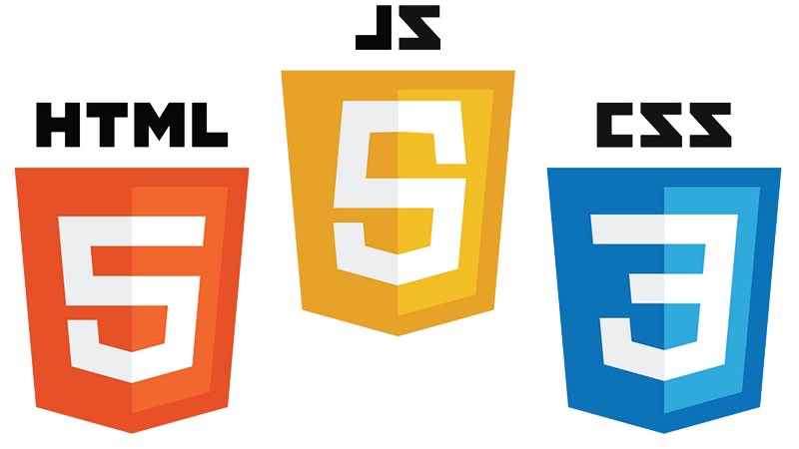
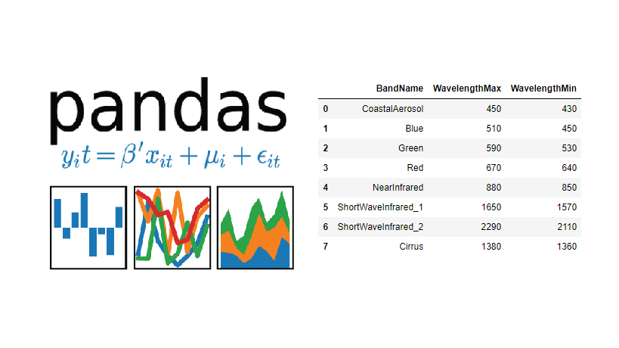




Technologies & Tools

Slide 4
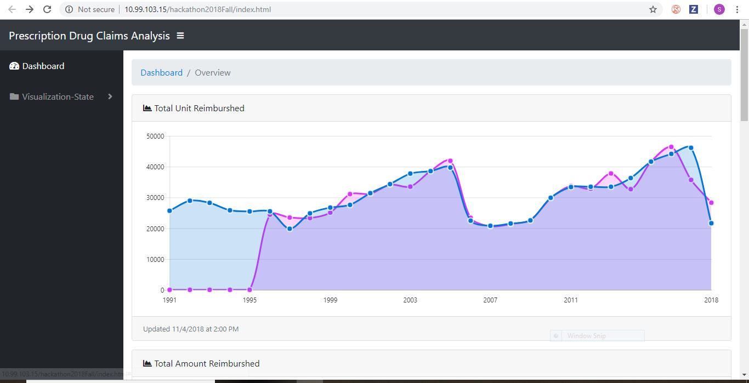
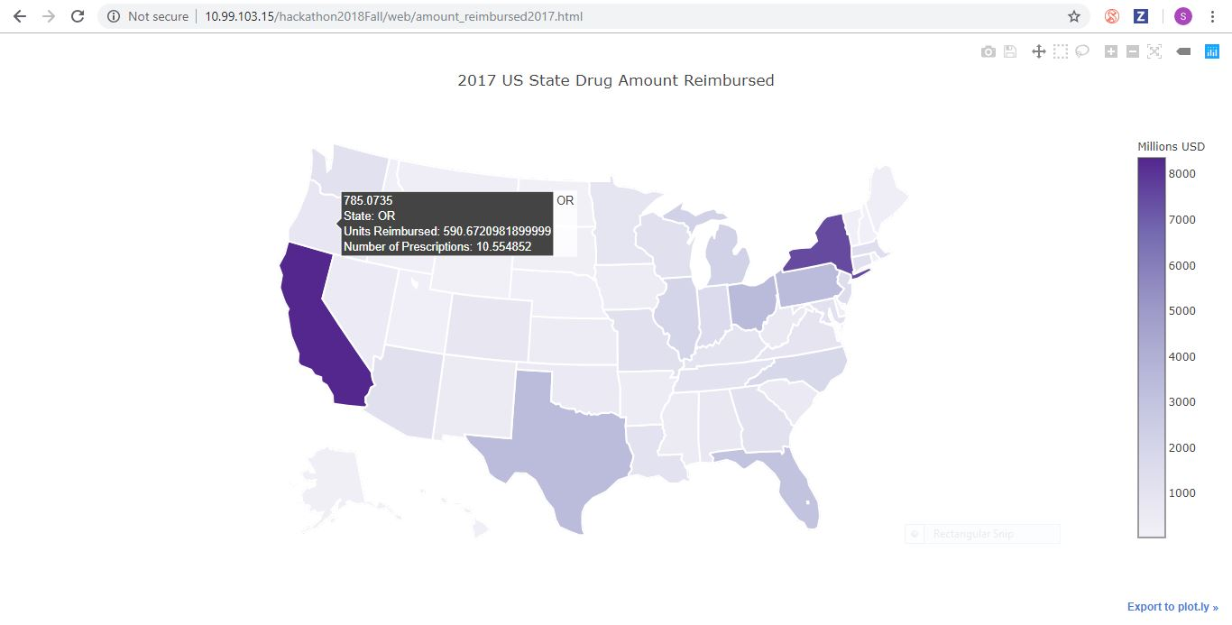
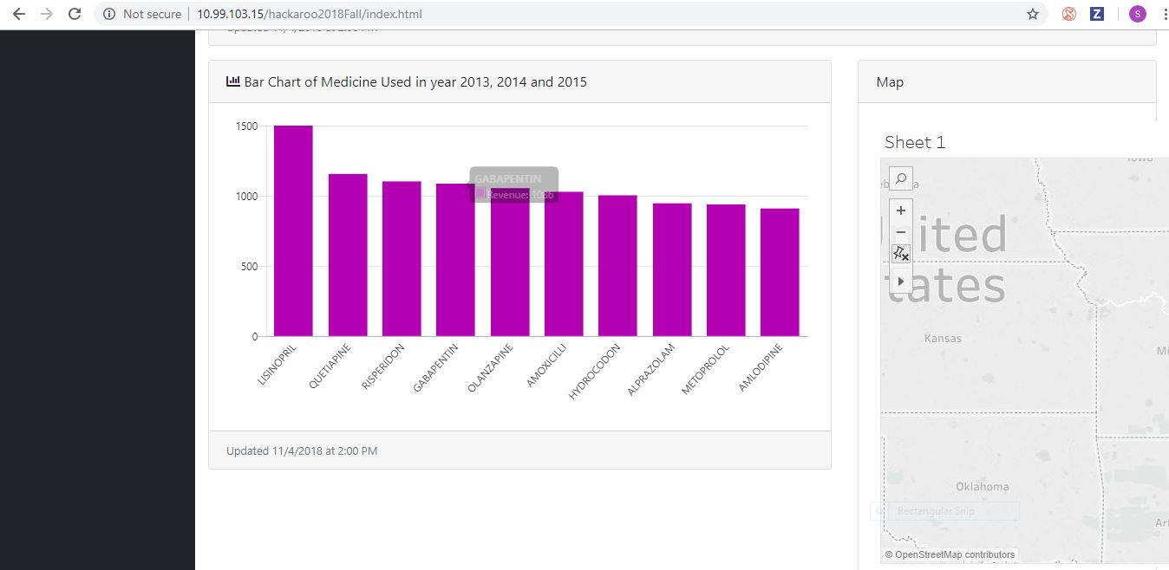
User Interface

Slide 5
